Slide 1

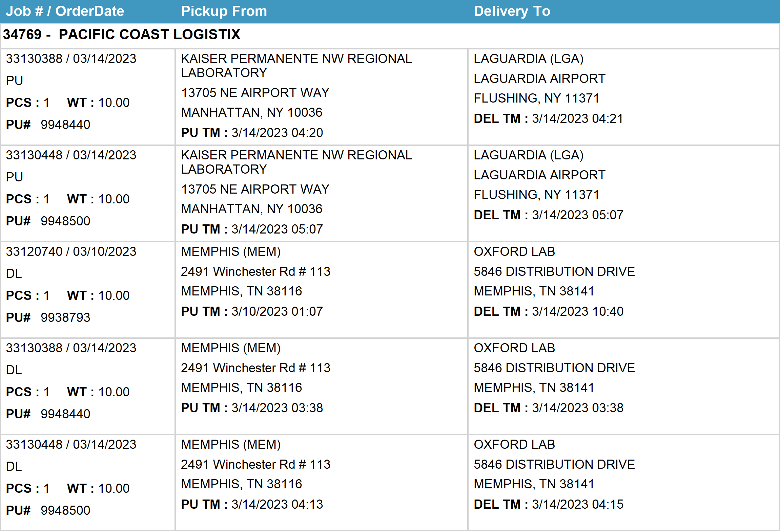
Agent Activity Report
*Data provided should be considered CONFIDENTIAL and PROPRIETARY*
©2011-2023 MNX Global Logistics. All rights reserved.
3/22/2023 7:06 AM
Print User : selenium.automation

Slide 2
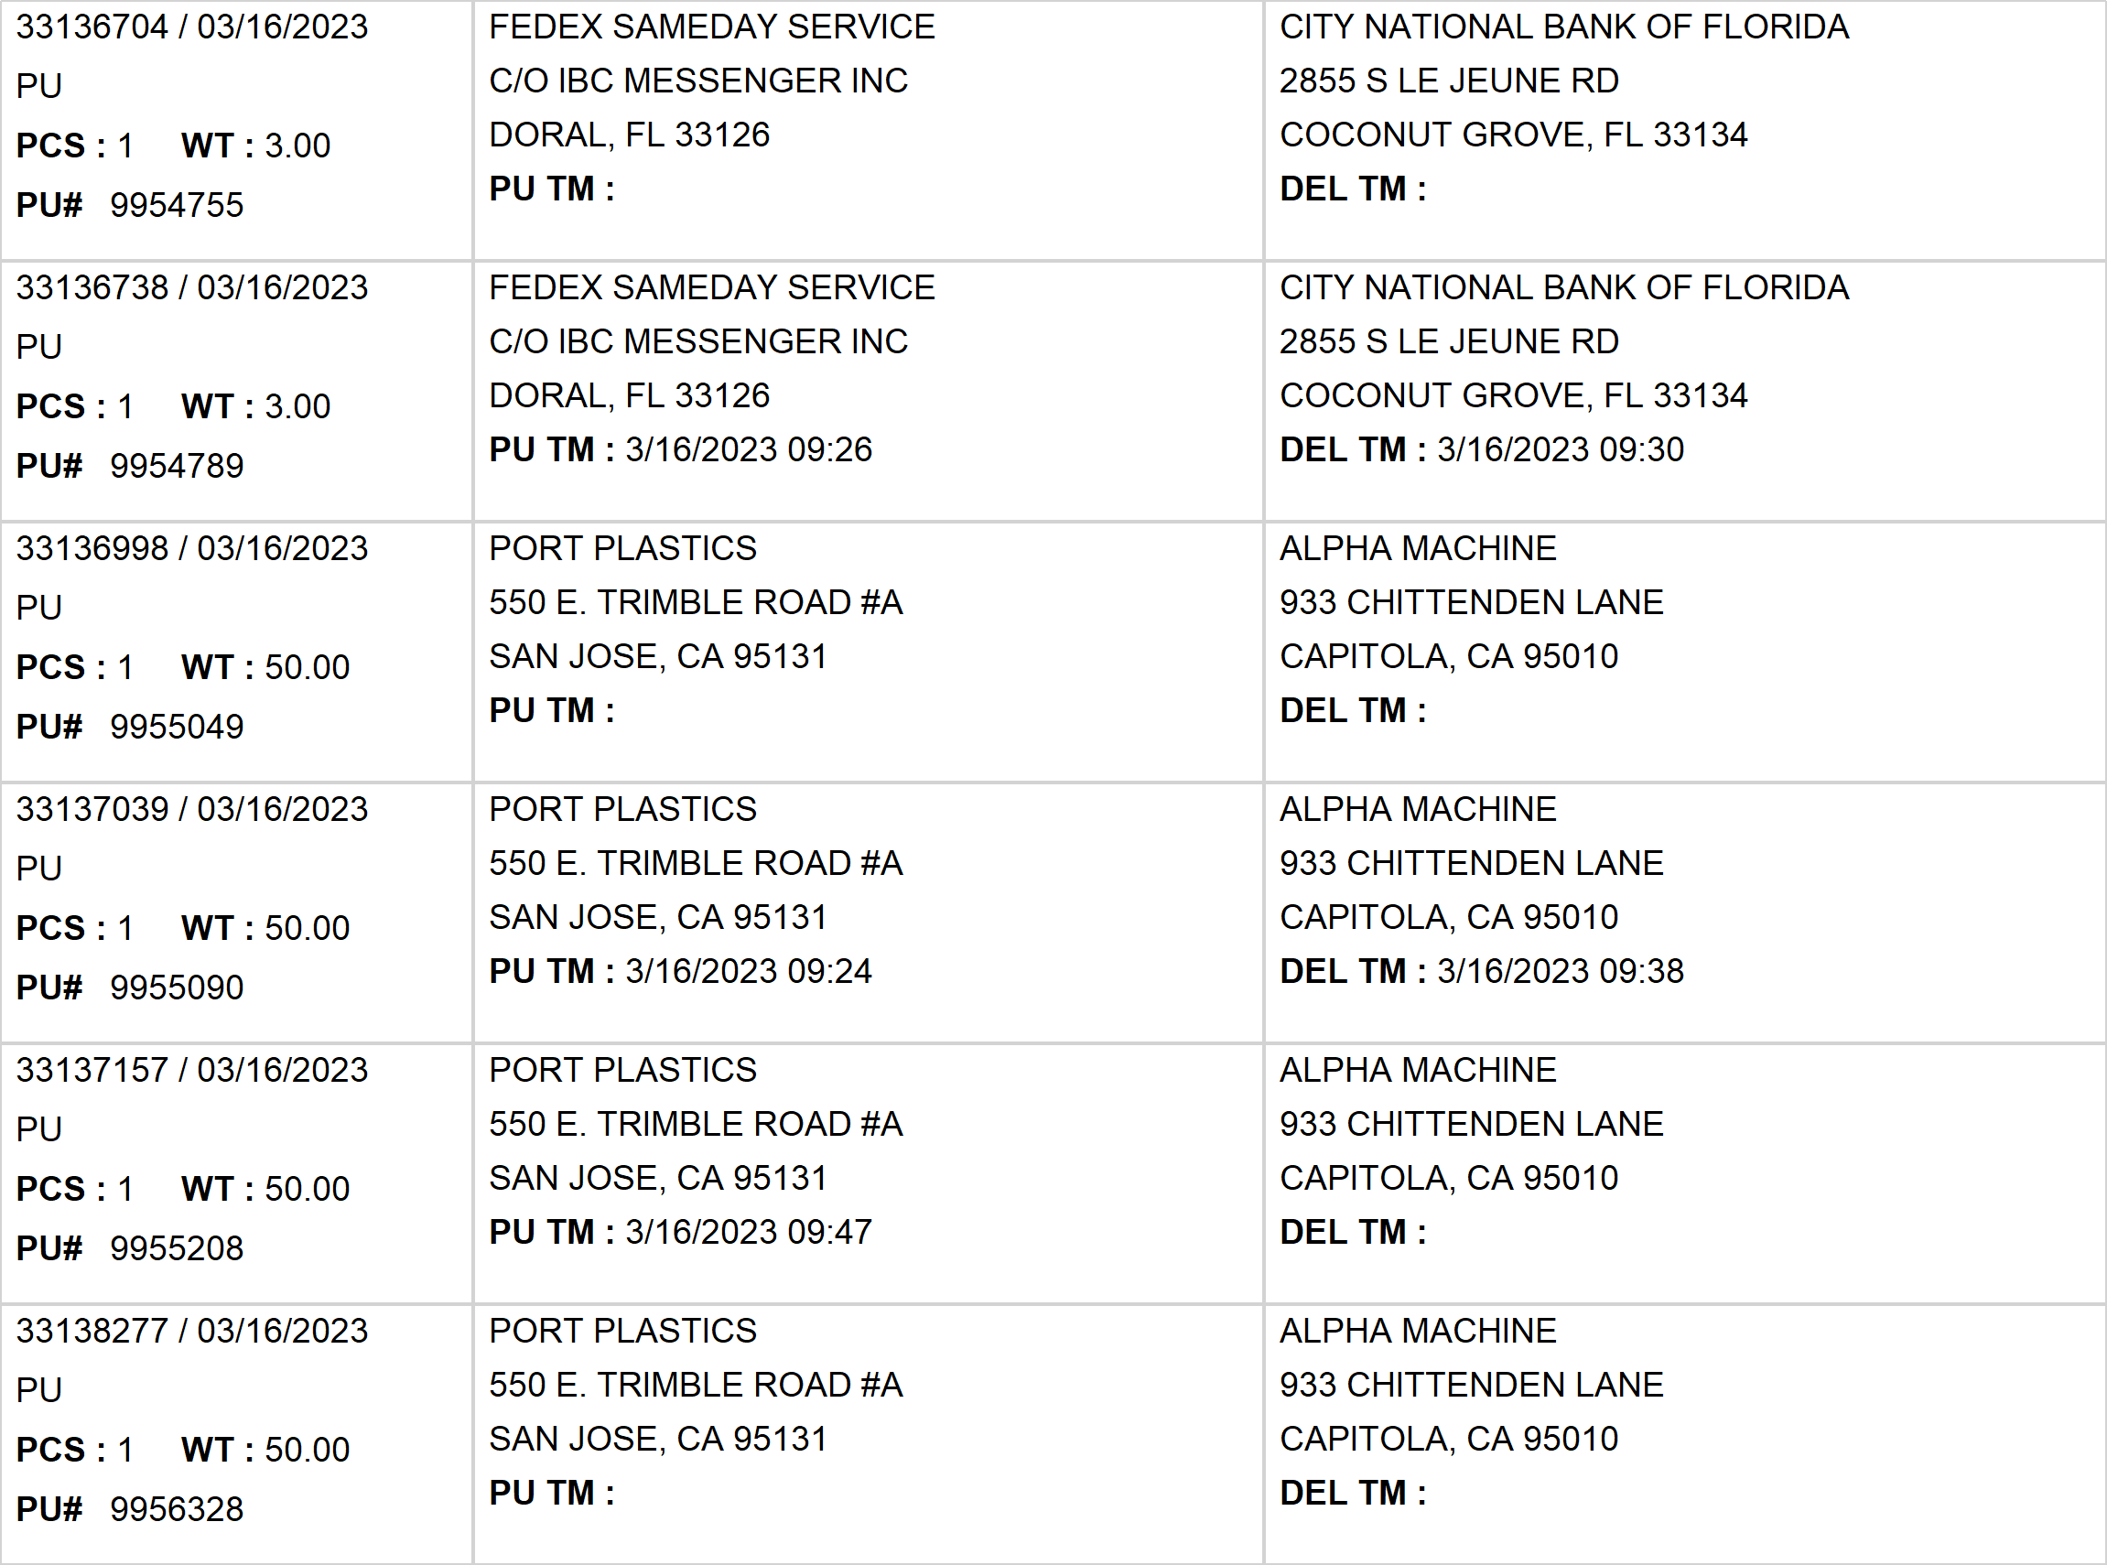
Agent Activity Report
*Data provided should be considered CONFIDENTIAL and PROPRIETARY*
©2011-2023 MNX Global Logistics. All rights reserved.
3/22/2023 7:06 AM
Print User : selenium.automation

Slide 3
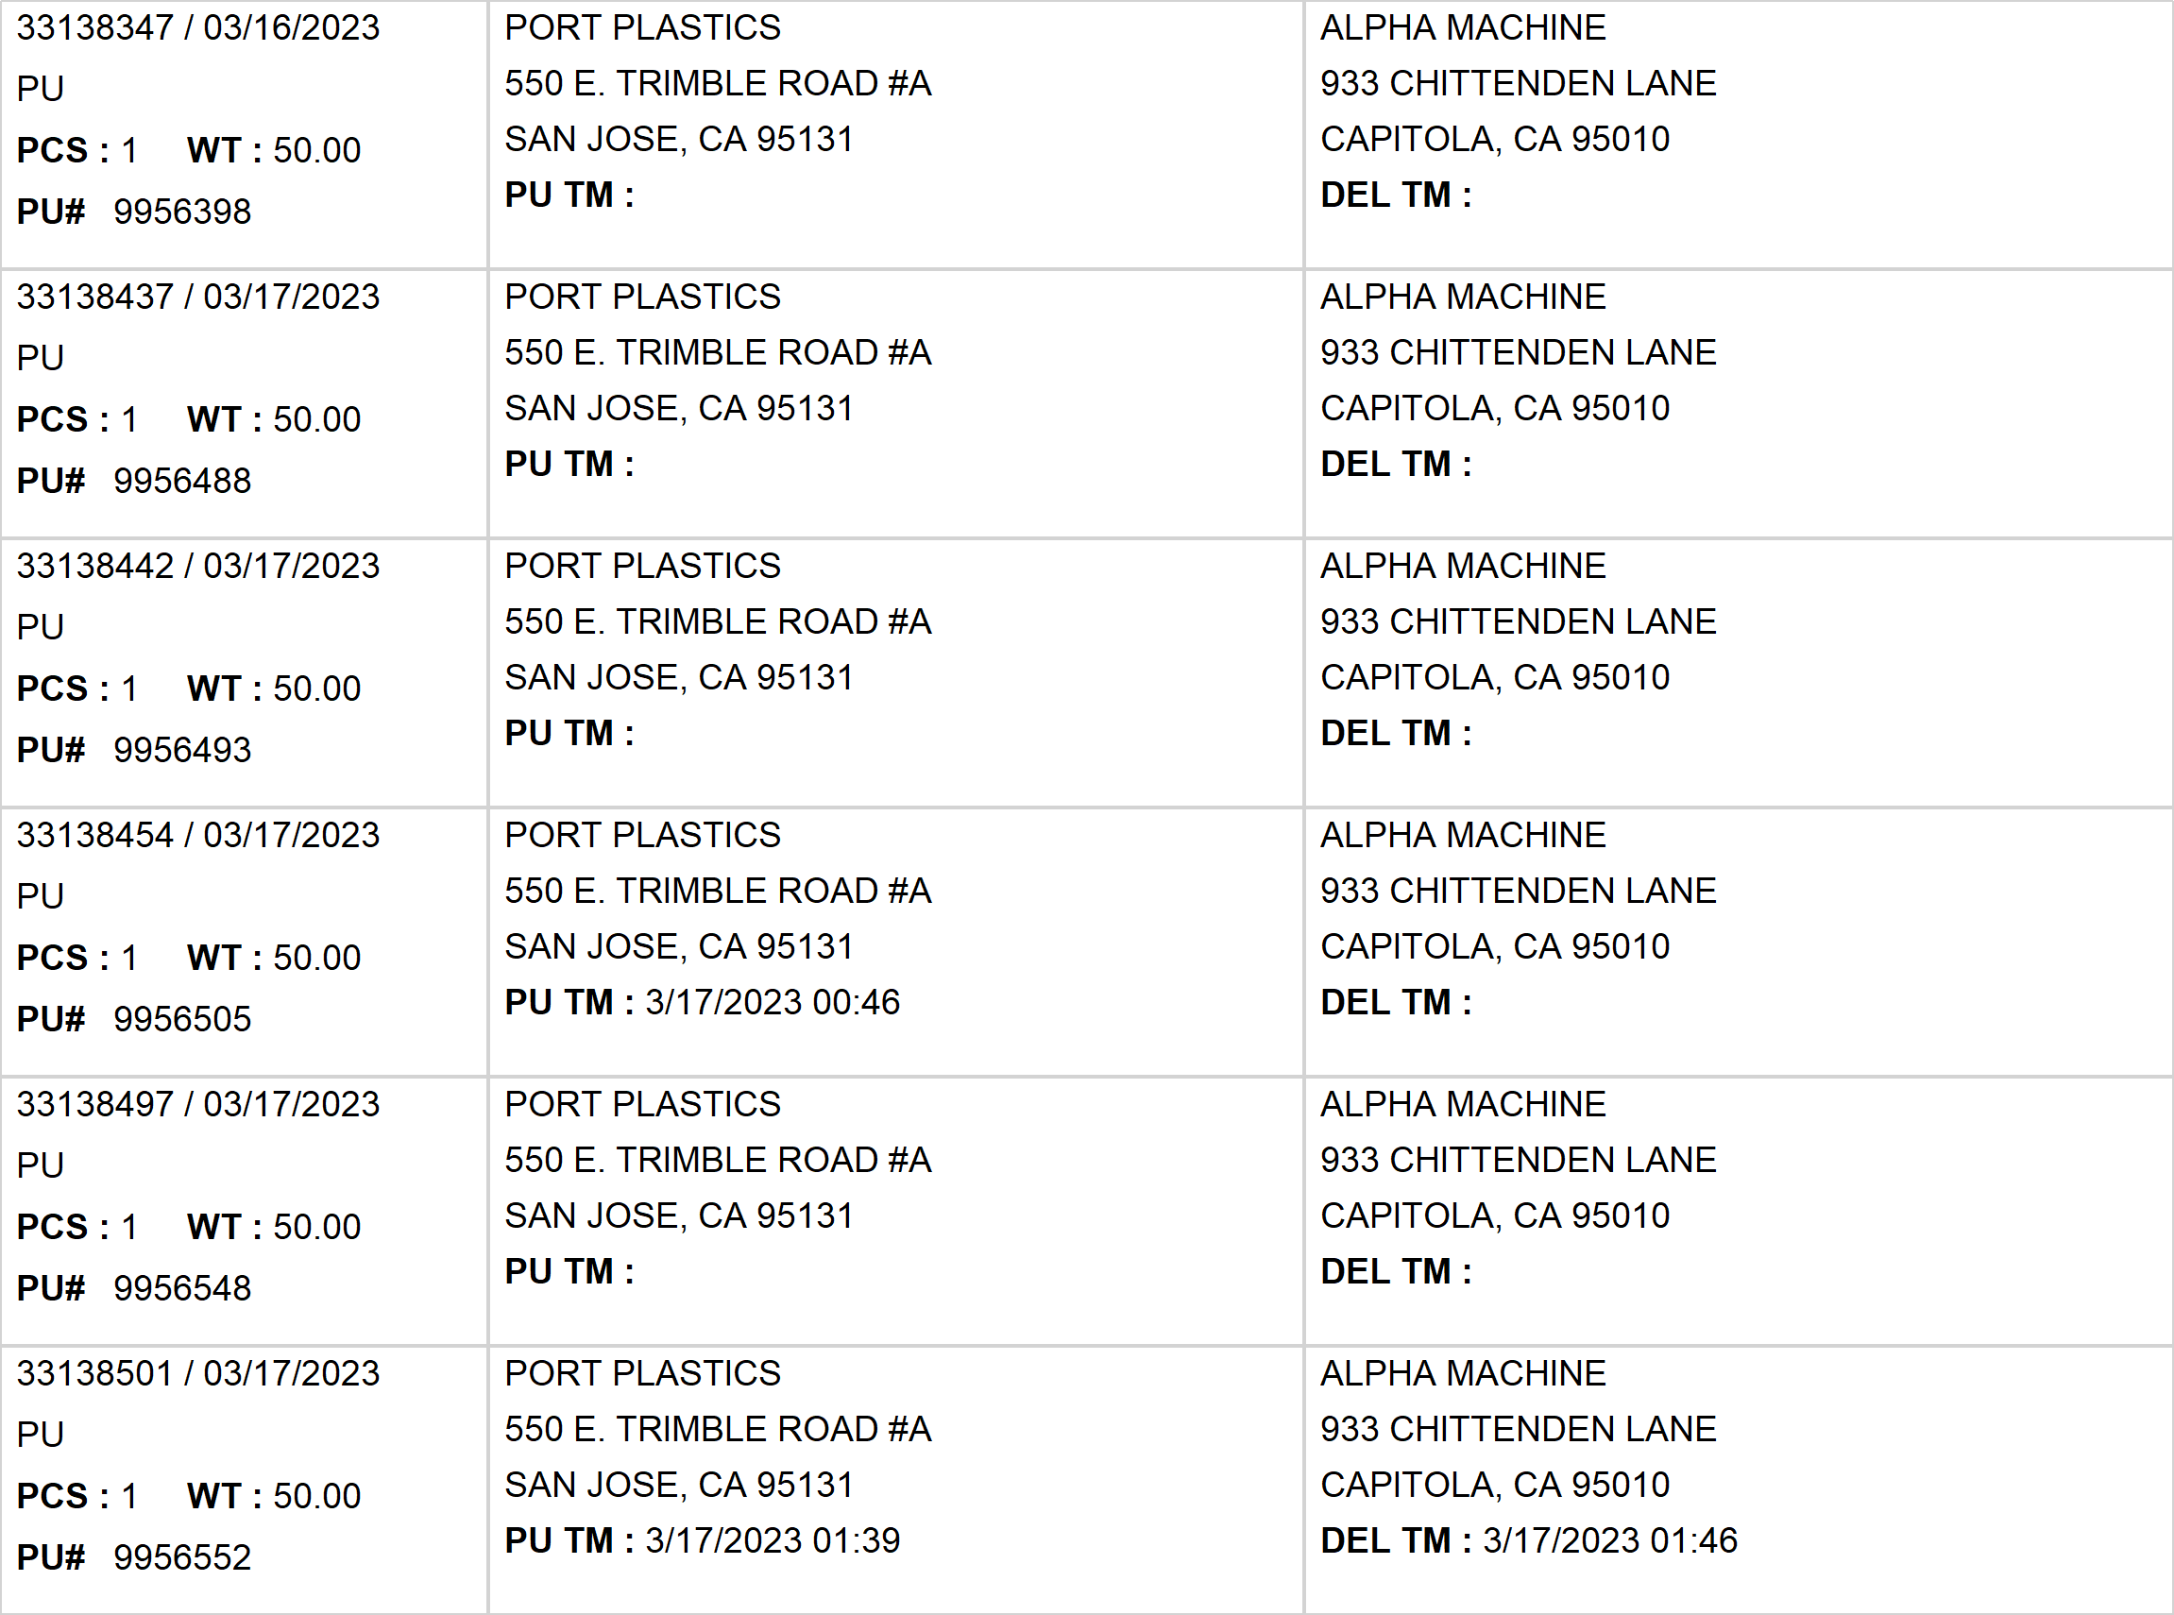
Agent Activity Report
*Data provided should be considered CONFIDENTIAL and PROPRIETARY*
©2011-2023 MNX Global Logistics. All rights reserved.
3/22/2023 7:06 AM
Print User : selenium.automation

Slide 4
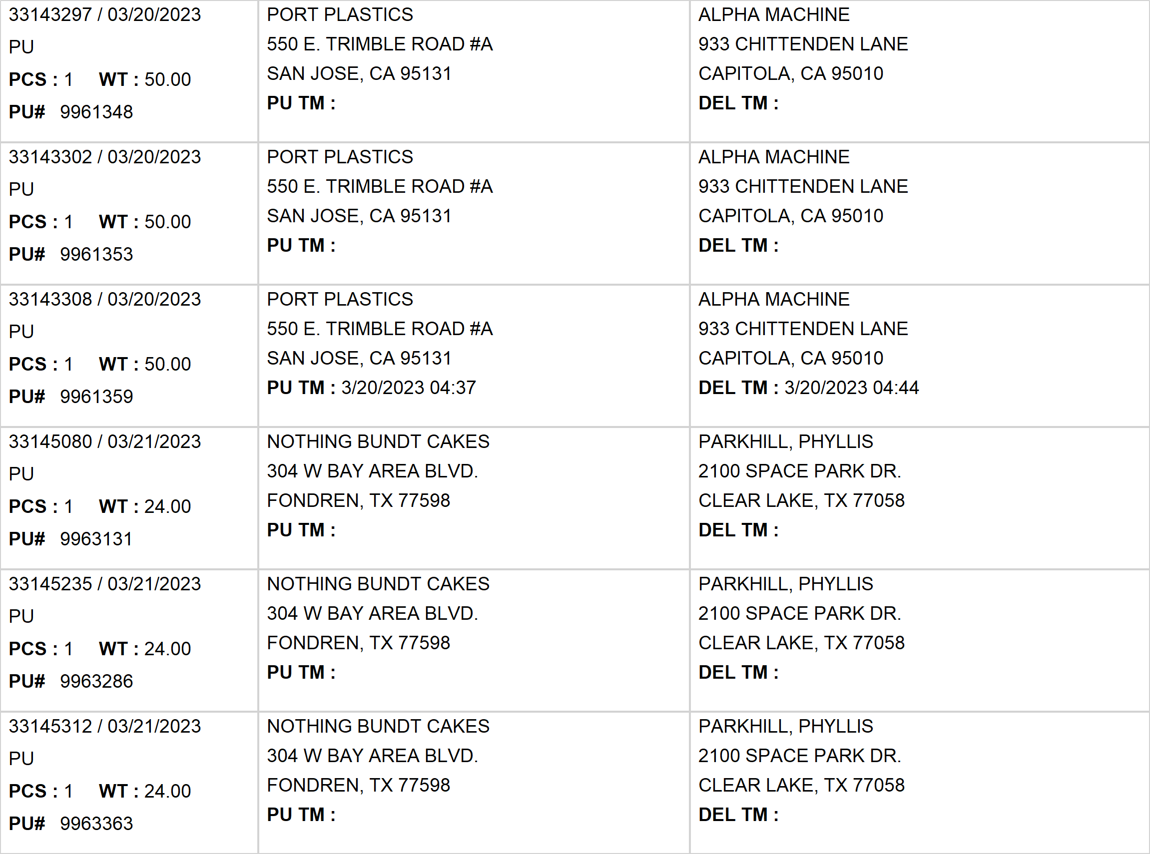
Agent Activity Report
*Data provided should be considered CONFIDENTIAL and PROPRIETARY*
©2011-2023 MNX Global Logistics. All rights reserved.
3/22/2023 7:06 AM
Print User : selenium.automation

Slide 5
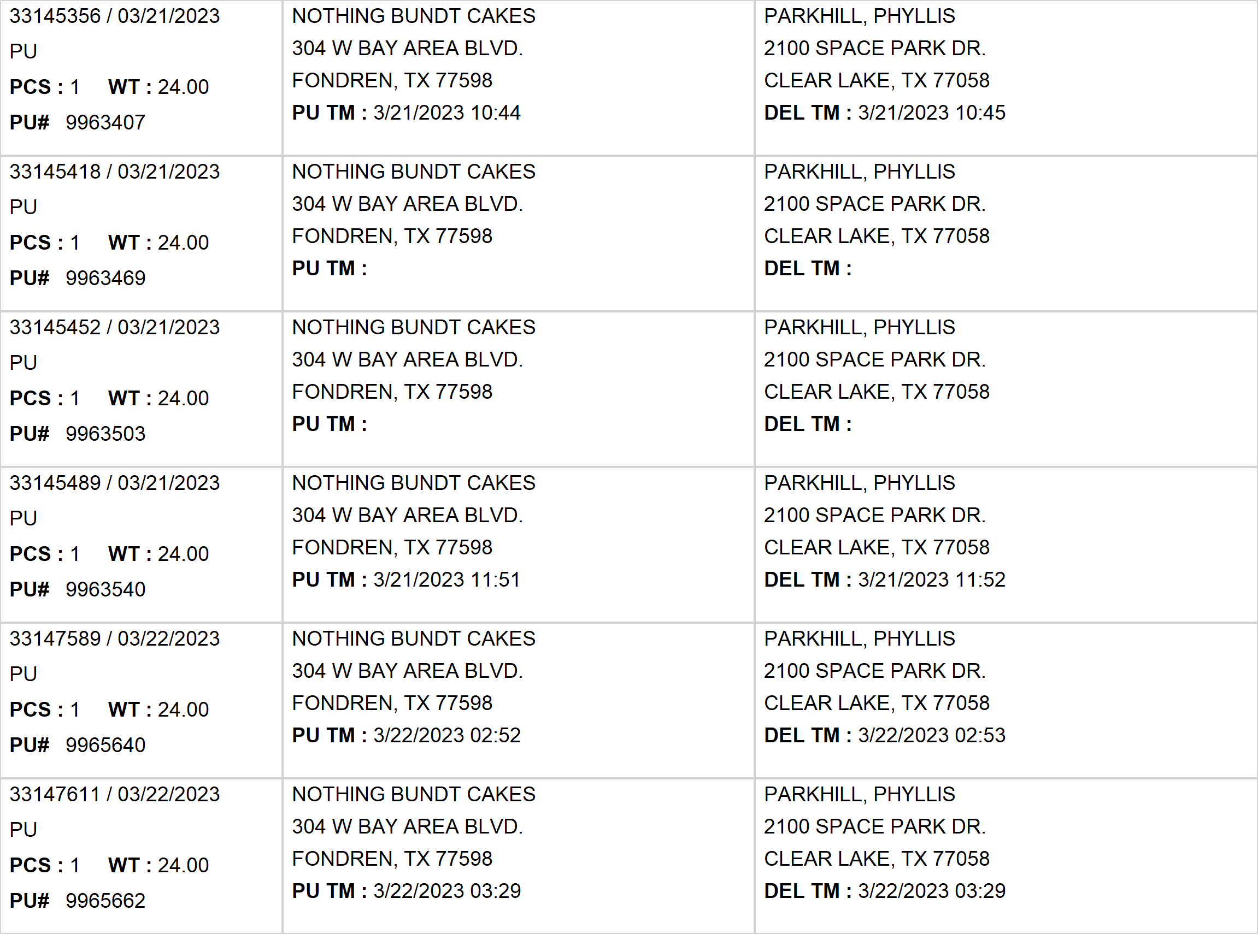
Agent Activity Report
*Data provided should be considered CONFIDENTIAL and PROPRIETARY*
©2011-2023 MNX Global Logistics. All rights reserved.
3/22/2023 7:06 AM
Print User : selenium.automation

Slide 6
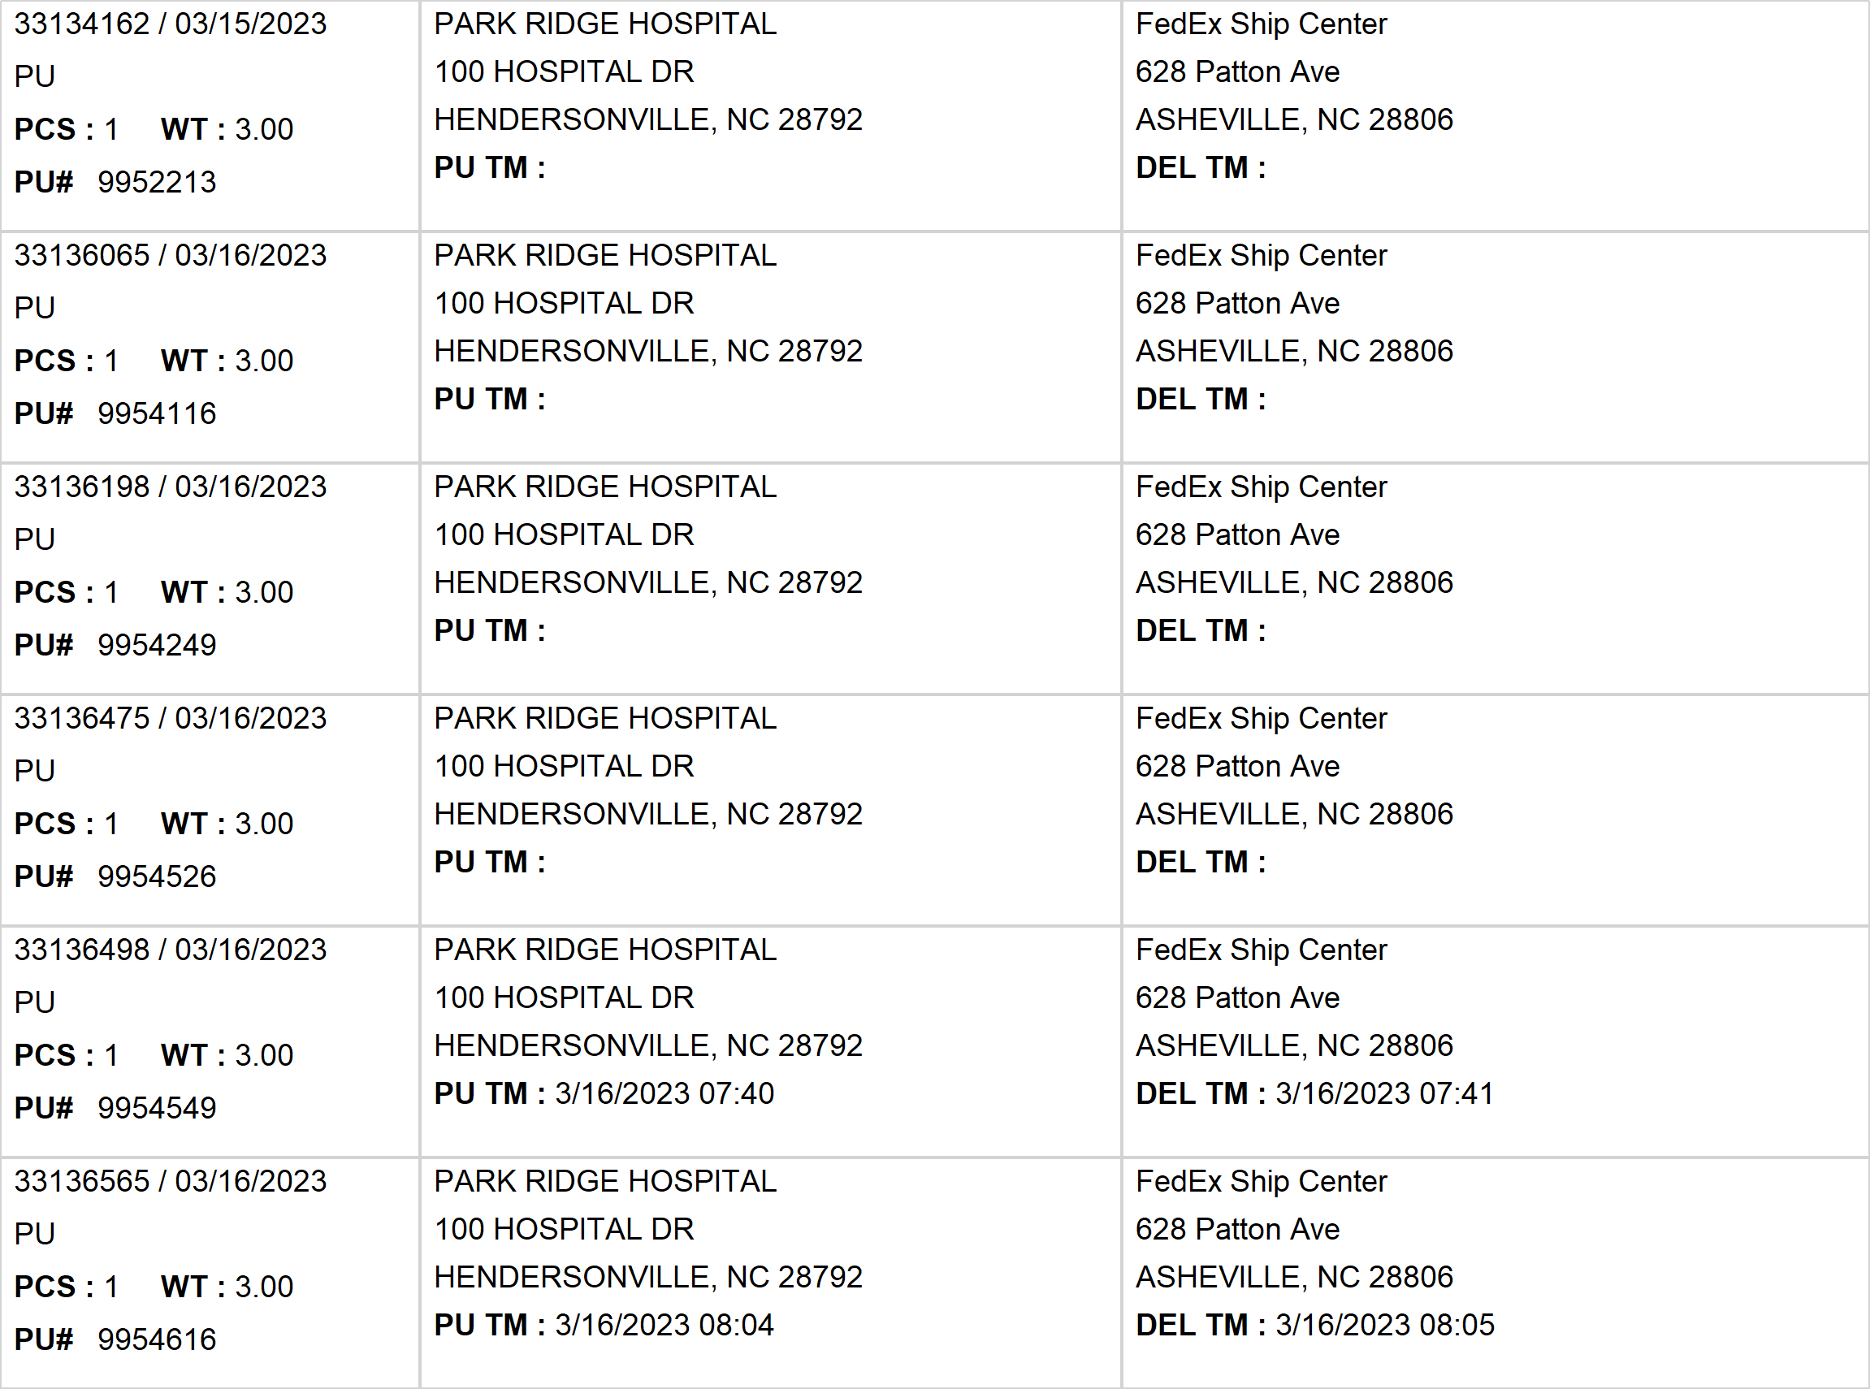
Agent Activity Report
*Data provided should be considered CONFIDENTIAL and PROPRIETARY*
©2011-2023 MNX Global Logistics. All rights reserved.
3/22/2023 7:06 AM
Print User : selenium.automation

Slide 7
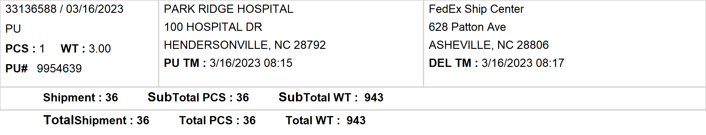
Agent Activity Report
*Data provided should be considered CONFIDENTIAL and PROPRIETARY*
©2011-2023 MNX Global Logistics. All rights reserved.
3/22/2023 7:06 AM
Print User : selenium.automation

